Slide 1
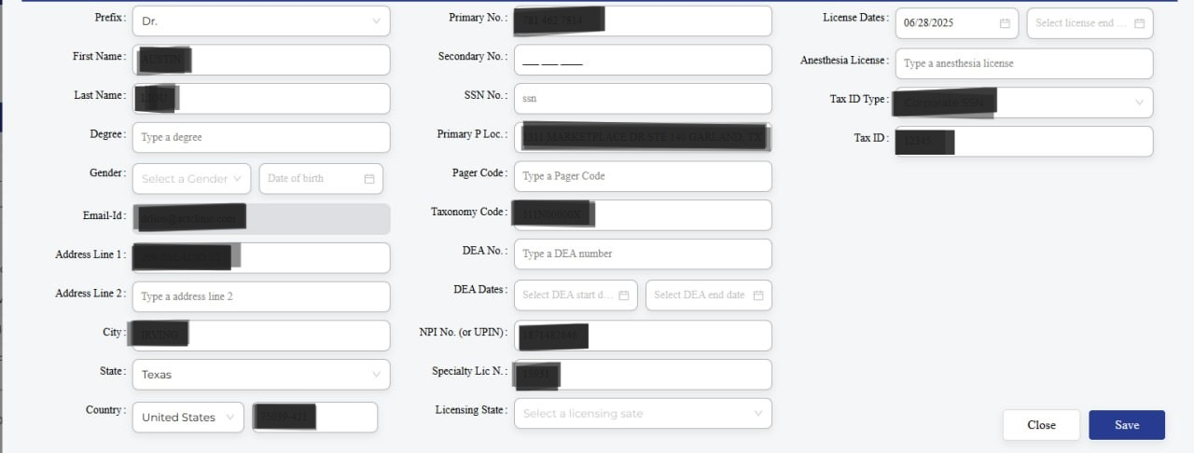
SOAP templates for orthopedic clinics, at Mynx software

Slide 2
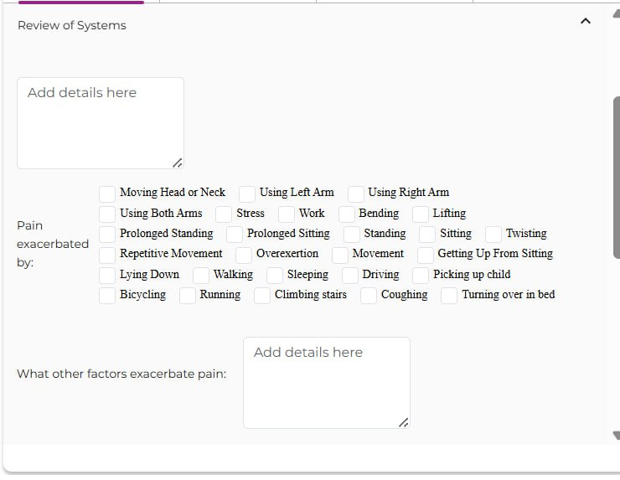
SOAP templates for orthopedic clinics, at Mynx software

Slide 3
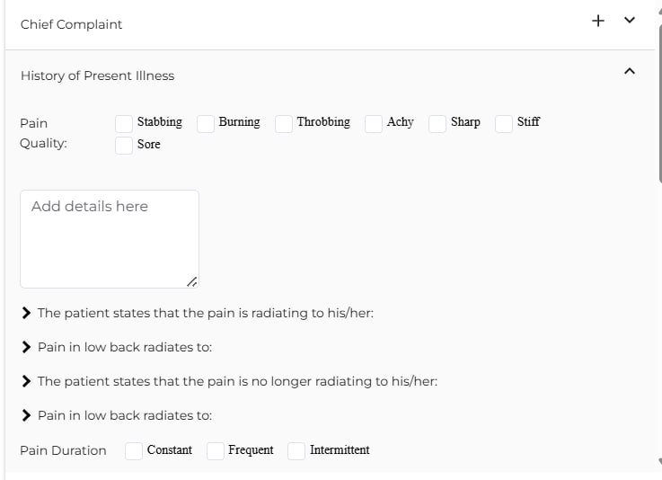
SOAP templates for orthopedic clinics, at Mynx software

Slide 4
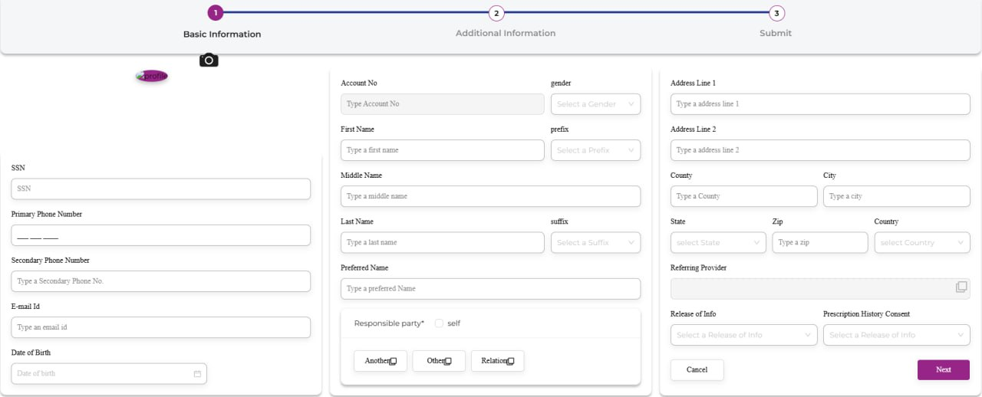
SOAP templates for orthopedic clinics, at Mynx software

Slide 5
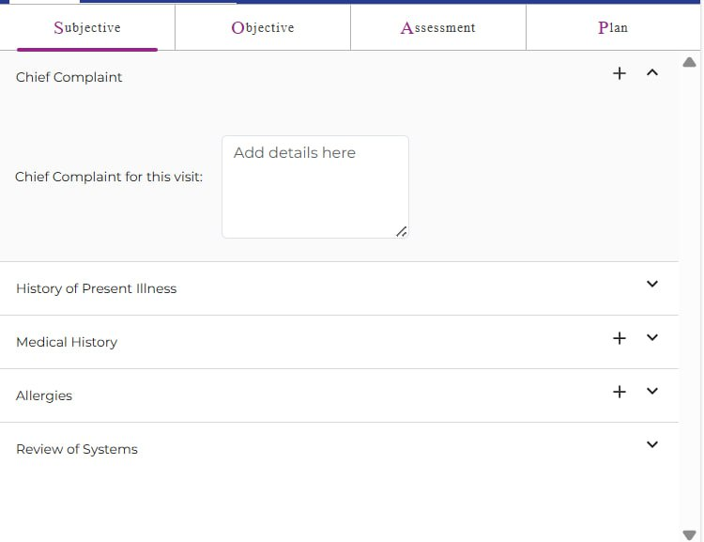
SOAP templates for orthopedic clinics, at Mynx software

