Slide 1
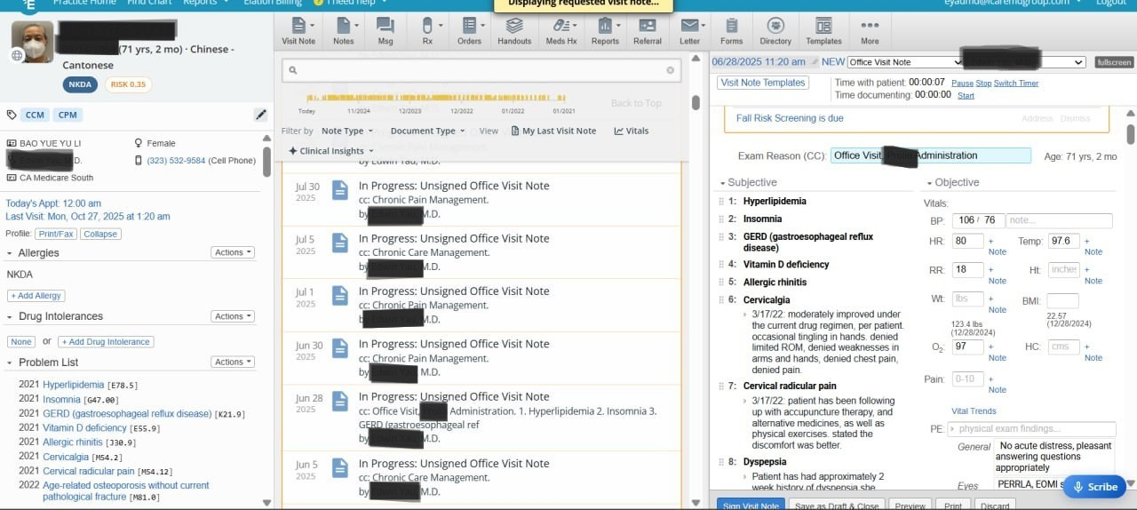
EHR Assistance & Insurance Claim Support

Slide 2
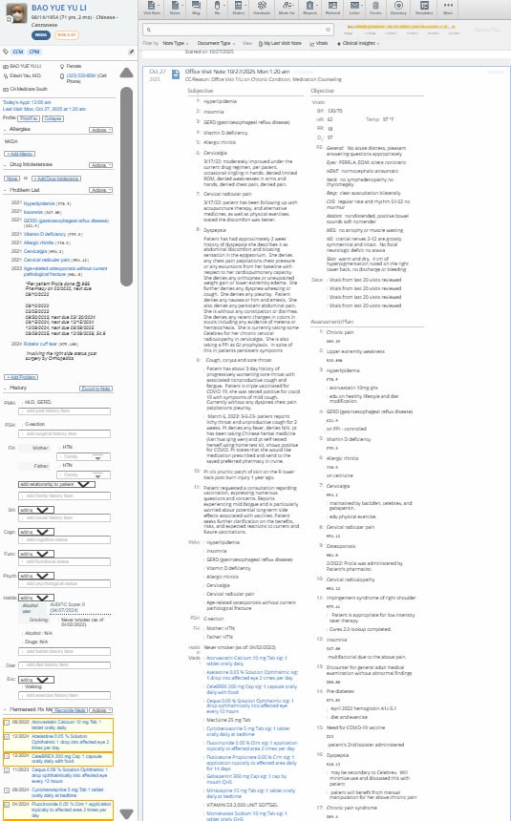
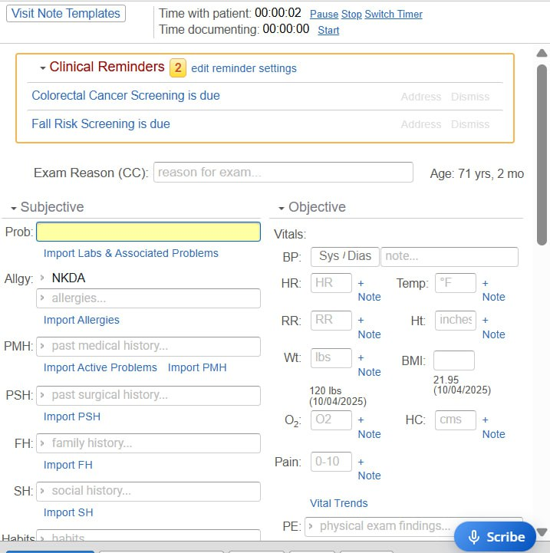
EHR Assistance &
Insurance Claim Support

